Slide 1
Verilog HDL简介示例

Slide 2
HDL to Gates
Simulation
Inputs applied to circuit
Outputs checked for correctness
Millions of dollars saved by debugging in simulation instead of hardware
Synthesis
Transforms HDL code into a netlist describing the hardware (i.e., a list of gates and the wires connecting them)
IMPORTANT:
When using an HDL, think of the hardware the HDL should produce

Slide 3
Verilog Modules
Two types of Modules:
Behavioral: describe what a module does
Structural: describe how it is built from simpler modules

Slide 4
Behavioral Verilog
Verilog:
module example(input a, b, c,
output y);
assign y = ~a & ~b & ~c | a & ~b & ~c | a & ~b & c;
endmodule
module/endmodule: required to begin/end module
example: name of the module
Operators:
~: NOT
&: AND
|: OR

Slide 5
HDL Synthesis
Verilog:
module example(input a, b, c,
output y);
assign y = ~a & ~b & ~c | a & ~b & ~c | a & ~b & c;
endmodule
Synthesis:

Slide 6
Verilog Syntax
Case sensitive
Example: reset and Reset are not the same signal.
No names that start with numbers
Example: 2mux is an invalid name
Whitespace ignored
Comments:
// single line comment
/* multiline
comment */

Slide 7
Structural Modeling - Hierarchy
module and3(input a, b, c,
output y);
assign y = a & b & c;
endmodule
module inv(input a,
output y);
assign y = ~a;
endmodule
module nand3(input a, b, c
output y);
wire n1; // internal signal
and3 andgate(a, b, c, n1); // instance of and3
inv inverter(n1, y); // instance of inv
endmodule

Slide 8
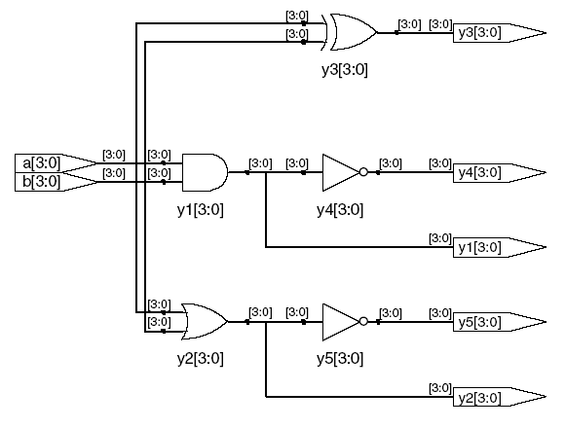
Bitwise Operators
module gates(input [3:0] a, b,
output [3:0] y1, y2, y3, y4, y5);
/* Five different two-input logic
gates acting on 4 bit busses */
assign y1 = a & b; // AND
assign y2 = a | b; // OR
assign y3 = a ^ b; // XOR
assign y4 = ~(a & b); // NAND
assign y5 = ~(a | b); // NOR
endmodule
// single line comment
/*…*/ multiline comment

Slide 9
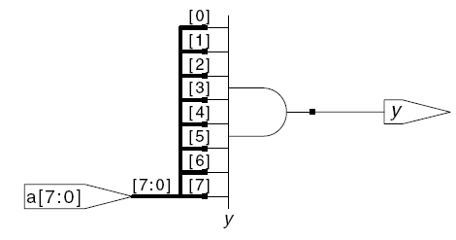
Reduction Operators
module and8(input [7:0] a,
output y);
assign y = &a;
// &a is much easier to write than
// assign y = a[7] & a[6] & a[5] & a[4] &
// a[3] & a[2] & a[1] & a[0];
endmodule

Slide 10
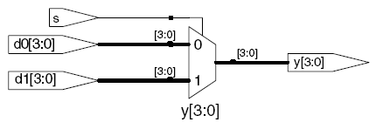
Conditional Assignment
module mux2(input [3:0] d0, d1,
input s,
output [3:0] y);
assign y = s ? d1 : d0;
endmodule
? : is also called a ternary operator because it
operates on 3 inputs: s, d1, and d0.

Slide 11
Internal Variables
module fulladder(input a, b, cin,
output s, cout);
wire p, g; // internal nodes
assign p = a ^ b;
assign g = a & b;
assign s = p ^ cin;
assign cout = g | (p & cin);
endmodule

Slide 12
Precedence
Order of operations
Highest
~ | NOT
*, /, % | mult, div, mod
+, - | add,sub
<<, >> | shift
<<<, >>> | arithmetic shift
<, <=, >, >= | comparison
==, != | equal, not equal
&, ~& | AND, NAND
^, ~^ | XOR, XNOR
|, ~| | OR, NOR
?: | ternary operator
Lowest

Slide 13
Numbers
Format: N'Bvalue
N = number of bits, B = base
N'B is optional but recommended (default is decimal)
Number | # Bits | Base | Decimal Equivalent | Stored
3'b101 | 3 | binary | 5 | 101
'b11 | unsized | binary | 3 | 00…0011
8'b11 | 8 | binary | 3 | 00000011
8'b1010_1011 | 8 | binary | 171 | 10101011
3'd6 | 3 | decimal | 6 | 110
6'o42 | 6 | octal | 34 | 100010
8'hAB | 8 | hexadecimal | 171 | 10101011
42 | Unsized | decimal | 42 | 00…0101010

Slide 14
Bit Manipulations: Example 1
assignVerilog {3{b[0]}}, a[0], 6'b100_010};
// if y is a 12-bit signal, the above statement produces:
y = a[2] a[1] b[0] b[0] b[0] a[0] 1 0 0 0 1 0
// underscores (_) are used for formatting only to make it easier to read. Verilog ignores them.

Slide 15
Bit Manipulations: Example 2
Verilog:
module mux2_8(input [7:0] d0, d1,
input s,
output [7:0] y);
mux2 lsbmux(d0[3:0], d1[3:0], s, y[3:0]);
mux2 msbmux(d0[7:4], d1[7:4], s, y[7:4]);
endmodule

Slide 16
Z: Floating Output
Verilog:
module tristate(input [3:0] a,
input en,
output [3:0] y);
assign y = en ? a : 4'bz;
endmodule

Slide 17
Always Statement
General Structure:
always @(sensitivity list)
statement;
Whenever the event in sensitivity list occurs, statement is executed

Slide 18
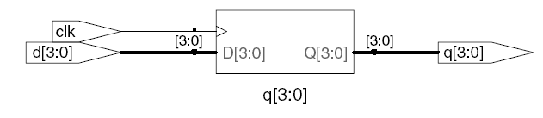
D Flip-Flop
module flop(input clk,
input [3:0] d,
output [3:0] q);
always@(posedge clk)
q <= d; // pronounced “q gets d”
endmodule

Slide 19
Resettable D Flip-Flop
module flopr(input clk,
input reset,
input [3:0] d,
output [3:0] q);
// synchronous reset
always@(posedge clk)
if (reset) q <= 4'b0;
else q <= d;
endmodule

Slide 20
Resettable D Flip-Flop
module flopr(input clk,
input reset,
input [3:0] d,
output [3:0] q);
// asynchronous reset
always @(posedge clk, posedge reset)
if (reset) q <= 4'b0;
else q <= d;
endmodule

Slide 21
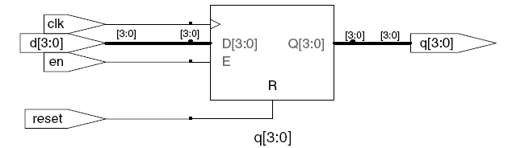
D Flip-Flop with Enable
module flopren(input clk,
input reset,
input en,
input [3:0] d,
output [3:0] q);
// asynchronous reset and enable
always@(posedge clk, posedge reset)
if (reset) q <= 4'b0;
else if (en) q <= d;
endmodule

Slide 22
Latch
module latch(input clk,
input [3:0] d,
output reg [3:0] q);
always@(*)
if (clk) q <= d;
endmodule
Warning: We don’t use latches in this text. But you might write code that inadvertently implies a latch. Check synthesized hardware – if it has latches
in it, there’s an error.

Slide 23
Other Behavioral Statements
Statements that must be inside always statements:
if / else
case, casez

Slide 24
Combinational Logic using always
// combinational logic using an always statement
module gates(input [3:0] a, b,
output reg [3:0] y1, y2, y3, y4, y5);
always@(*) // need begin/end because there is
begin // more than one statement in always
y1 = a & b; // AND
y2 = a | b; // OR
y3 = a ^ b; // XOR
y4 = ~(a & b); // NAND
y5 = ~(a | b); // NOR
end
endmodule
This hardware could be described with assign statements using fewer lines of code, so it’s better to use assign statements in this case.

Slide 25
Combinational Logic using case
module sevenseg(input [3:0] data,
output reg [6:0] segments);
always@(*)
case (data)
// abc_defg
0: segments = 7'b111_1110;
1: segments = 7'b011_0000;
2: segments = 7'b110_1101;
3: segments = 7'b111_1001;
4: segments = 7'b011_0011;
5: segments = 7'b101_1011;
6: segments = 7'b101_1111;
7: segments = 7'b111_0000;
8: segments = 7'b111_1111;
9: segments = 7'b111_0011;
default: segments = 7'b000_0000; // required
endcase
endmodule

Slide 26
Combinational Logic using case
case statement implies combinational logic only if all possible input combinations described
Remember to use default statement

Slide 27
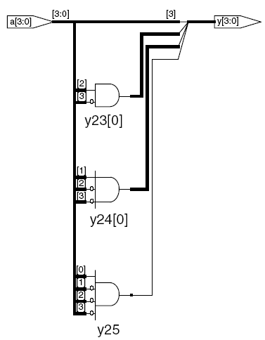
Combinational Logic using casez
module priority_casez(input [3:0] a,
output reg [3:0] y);
always@(*)
casez(a)
4'b1???: y = 4'b1000; // ? = don’t care
4'b01??: y = 4'b0100;
4'b001?: y = 4'b0010;
4'b0001: y = 4'b0001;
default: y = 4'b0000;
endcase
endmodule

Slide 28
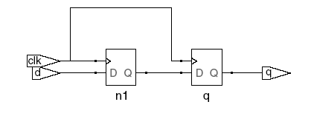

Blocking vs. Nonblocking Assignment
<= is nonblocking assignment
Occurs simultaneously with others
= is blocking assignment
Occurs in order it appears in file
// Good synchronizer using
// nonblocking assignments
module syncgood(input clk,
input d,
output reg q);
reg n1;
always@(posedge clk)
begin
n1 <= d; // nonblocking
q <= n1; // nonblocking
end
endmodule
// Bad synchronizer using
// blocking assignments
module syncbad(input clk,
input d,
output reg q);
reg n1;
always@(posedge clk)
begin
n1 = d; // blocking
q = n1; // blocking
end
endmodule

Slide 29
Parameterized Modules
2:1 mux:
module mux2
#(parameter width = 8) // name and default value
(input [width-1:0] d0, d1,
input s,
output [width-1:0] y);
assign y = s ? d1 : d0;
endmodule
Instance with 8-bit bus width (uses default):
mux2 myMux(d0, d1, s, out);
Instance with 12-bit bus width:
mux2 #(12) lowmux(d0, d1, s, out);

Slide 30
Testbenches
HDL that tests another module: device under test (dut)
Not synthesizeable
Types:
Simple
Self-checking
Self-checking with testvectors

Slide 31
Testbench Example
Write Verilog code to implement the following function in hardware:
y = bc + ab
Name the module sillyfunction

Slide 32
Testbench Example
Write Verilog code to implement the following function in hardware:
y = bc + ab
module sillyfunction(input a, b, c,
output y);
assign y = ~b & ~c | a & ~b;
endmodule

Slide 33
Simple Testbench
module testbench1();
reg a, b, c;
wire y;
// instantiate device under test
sillyfunction dut(a, b, c, y);
// apply inputs one at a time
initial begin
a = 0; b = 0; c = 0; #10;
c = 1; #10;
b = 1; c = 0; #10;
c = 1; #10;
a = 1; b = 0; c = 0; #10;
c = 1; #10;
b = 1; c = 0; #10;
c = 1; #10;
end
endmodule

Slide 34
Self-checking Testbench
module testbench2();
reg a, b, c;
wire y;
sillyfunction dut(a, b, c, y); // instantiate dut
initial begin // apply inputs, check results one at a time
a = 0; b = 0; c = 0; #10;
if (y !== 1) $display("000 failed.");
c = 1; #10;
if (y !== 0) $display("001 failed.");
b = 1; c = 0; #10;
if (y !== 0) $display("010 failed.");
c = 1; #10;
if (y !== 0) $display("011 failed.");
a = 1; b = 0; c = 0; #10;
if (y !== 1) $display("100 failed.");
c = 1; #10;
if (y !== 1) $display("101 failed.");
b = 1; c = 0; #10;
if (y !== 0) $display("110 failed.");
c = 1; #10;
if (y !== 0) $display("111 failed.");
end
endmodule

Slide 35
Testbench with Testvectors
Testvector file: inputs and expected outputs
Testbench:
Generate clock for assigning inputs, reading outputs
Read testvectors file into array
Assign inputs, expected outputs
Compare outputs with expected outputs and report errors

Slide 36
Testbench with Testvectors
Testbench clock:
assign inputs (on rising edge)
compare outputs with expected outputs (on falling edge).
Testbench clock also used as clock for synchronous sequential circuits

Slide 37
Testvectors File
File: example.tv
contains vectors of abc_yexpected
000_1
001_0
010_0
011_0
100_1
101_1
110_0
111_0

Slide 38
1. Generate Clock
module testbench3();
reg clk, reset;
reg a, b, c, yexpected;
wire y;
reg [31:0] vectornum, errors; // bookkeeping variables
reg [3:0] testvectors[10000:0]; // array of testvectors
// instantiate device under test
sillyfunction dut(a, b, c, y);
// generate clock
always // no sensitivity list, so it always executes
begin
clk = 1; #5; clk = 0; #5;
end

Slide 39
2. Read Testvectors into Array
// at start of test, load vectors and pulse reset
initial
begin
$readmemb("example.tv", testvectors);
vectornum = 0; errors = 0;
reset = 1; #27; reset = 0;
end
// Note: $readmemh reads testvector files written in
// hexadecimal

Slide 40
3. Assign Inputs & Expected Outputs
// apply test vectors on rising edge of clk
always @(posedge clk)
begin
#1; {a, b, c, yexpected} = testvectors[vectornum];
end

Slide 41
4. Compare with Expected Outputs
// check results on falling edge of clk
always @(negedge clk)
if (~reset) begin // skip during reset
if (y !== yexpected) begin
$display("Error: inputs = %b", {a, b, c});
$display(" outputs = %b (%b expected)",y,yexpected);
errors = errors + 1;
end
// Note: to print in hexadecimal, use %h. For example,
// $display(“Error: inputs = %h”, {a, b, c});

Slide 42
4. Compare with Expected Outputs
// increment array index and read next testvector
vectornum = vectornum + 1;
if (testvectors[vectornum] === 4'bx) begin
$display("%d tests completed with %d errors",
vectornum, errors);
$finish;
end
end
endmodule
// === and !== can compare values that are 1, 0, x, or z.

